Slide 1
Test in one week
No class next Wednesday:
Use your extra time to study and make your equation sheet
HW due today

Slide 2
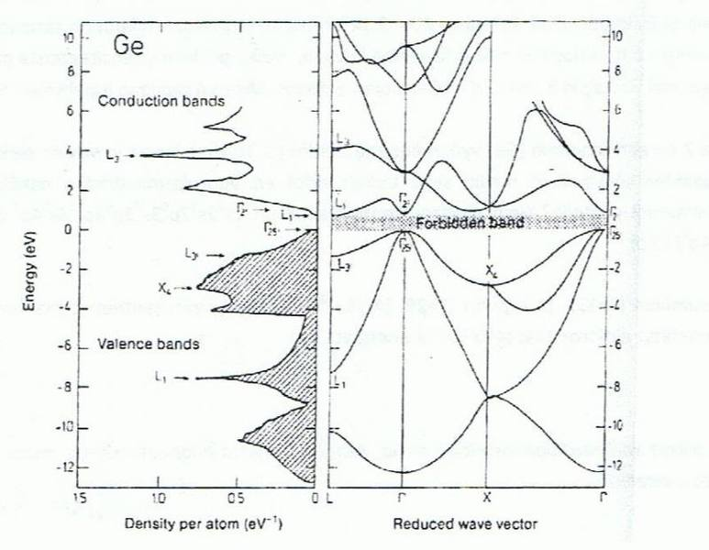
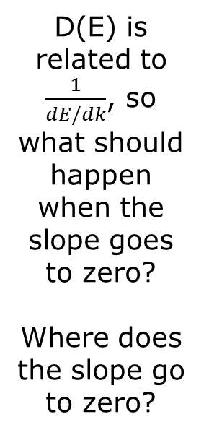
Relating Energy Bands to DOS
D(E) is related to $\frac{1}{dE/dk}$, so what should happen when the slope goes to zero?
Where does the slope go to zero?
Notes:
This and next two slides were brought on by guest speaker (Olivia), who showed some orbital contributions. May not show these otherwise.

Slide 3
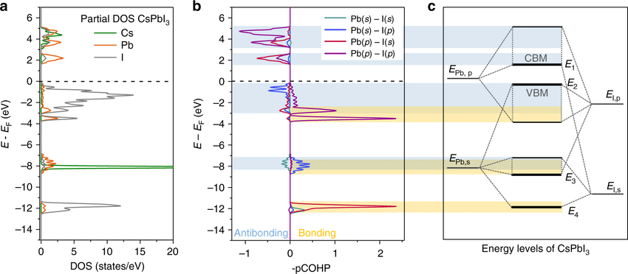
Relating Atomic Energy and DOS

Slide 4
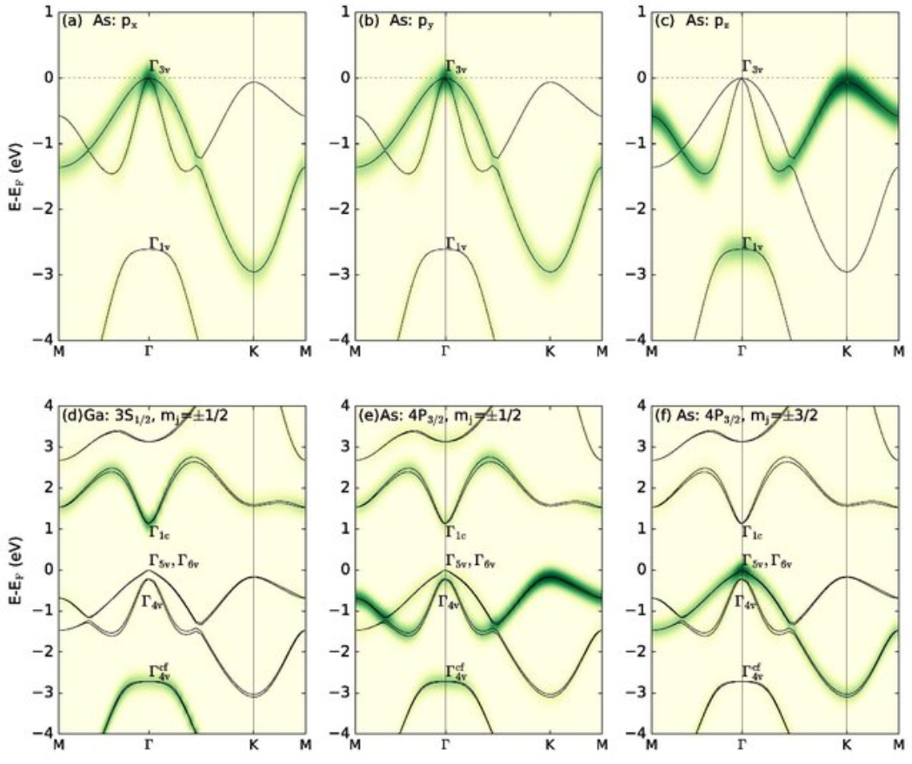
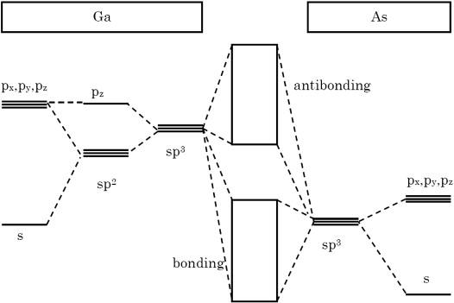
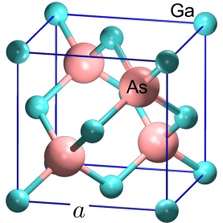
Orbital Contributions
Ground state electron energy dispersion in monolayer buckled GaAs in the absence of spin orbit coupling (SOC) demonstrating the p-DOS contributions from (a) px, (b) py and (c) pz orbitals of As. The difference Γ3v-Γ1v= -1.95 eV, signifying a strong crystal-field splitting. In the presence of an SOC, the p-DOS contributions for (d) Ga 3S 1/2 , mj=±1/2, (e) As 4P 3/2 , mj=±1/2 and (f) As 4P 3/2 , mj=±3/2 are demonstrated. The presence of SOC makes Γ1v-Γ cf 4v = -0.11 eV.
Notes:
Orbital contributions can sometimes be just one band, but it’s not common for interactions and hybridizations to result in coupled bands. Spin-orbit coupling refers to the interaction of a particle's "spin" motion with its "orbital" motion.

Slide 5
Band Structure
Linear H Chain
E(k)
E_{F}
0
k
π/a
The Fermi energy separates the filled states (E < E_{F} at T = 0 K) from the empty states (E > E_{F} at T = 0 K).

Slide 6
Band Structure
Linear H Chain
E(k)
E_{F}
0
k
π/a
The Fermi energy separates the filled states (E < E_{F} at T = 0 K) from the empty states (E > E_{F} at T = 0 K).
Here splits the band (each band holds 2 electrons per primitive cell)

Slide 7
Band Structure
Linear H Chain
E(k)
E_{F}
0
k
π/a
The Fermi energy separates the filled states (E < E_{F} at T = 0 K) from the empty states (E > E_{F} at T = 0 K).
Here splits the band (each band holds 2 electrons per primitive cell)
A 1D chain of H atoms is predicted to be metallic because the Fermi level cuts a band (there is no gap so it takes only an infinitesimal energy to excite an electron into an empty state).

Slide 8
Band Structure
Linear H Chain
E(k)
E_{F}
0
k
π/a
The Fermi energy separates the filled states (E < E_{F} at T = 0 K) from the empty states (E > E_{F} at T = 0 K).
Here splits the band (each band holds 2 electrons per primitive cell)
A 1D chain of H atoms is predicted to be metallic because the Fermi level cuts a band (there is no gap so it takes only an infinitesimal energy to excite an electron into an empty state).
The band runs "uphill" (from 0 to π/a) because it is lower energy for s orbitals to be in-phase (the symmetric solution) than out-of-phase (antisymmetric, antibonding)

Slide 9
How Bands “Run”
Ψ_{k} = Σ e^{ikna}χ_{n} (tight binding)
applies in general
It does not, however, say anything about whether the lowest energy should occur at k=0 or at the BZ edge.
Notes:
Antibonding, draw orbitals on board.

Slide 10

How Bands “Run”
Ψ_{k} = Σ e^{ikna}χ_{n} (tight binding)
applies in general
It does not, however, say anything about whether the lowest energy should occur at k=0 or at the BZ edge.
For a chain of H atoms (s orbitals) it is clear that
E(k = 0) < E(k = n/a), meaning they prefer to be in phase.
But consider a chain of p orbitals.
Is being in phase preferred? Why?
Notes:
Antibonding, draw orbitals on board.

Slide 11
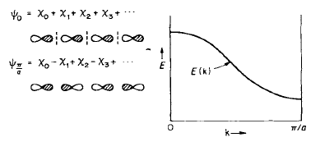
One electron in this p Orbital Runs Opposite to s

Slide 12
Group: Linear Chain of F
F: 1s²2s²2p_{x}²2p_{y}²2p_{z}¹
F
F
F
F
F
F
F
F
F
F
(a)
(b)
(c)
(d)
E_{F}
E_{F}
E(k)
E_{F}
E_{F}
0
k
π/a
0
k
π/a
0
k
π/a
0
k
π/a
Which of the following is the correct band structure for a linear chain of F atoms (atomic #=9)?
Notes:
How many total bands should there be? 9/2 rounded up=5. We are not showing the 1s band

Slide 13
Linear F Chain
There are 4 n=2 orbitals in the unit cell (a single F atom with 1 2s + 3 2p orbitals)
There is a lower 1s band (not shown)
E_{F}
E_{F}
E(k)
E_{F}
E_{F}
0
k
π/a
0
k
π/a
0
k
π/a
0
k
π/a

Slide 14
Band Structure: Linear Chain of F
Bonding 2s σ
Antibonding 2s σ∗
Which one of these has lower energy?

Slide 15
Linear F Chain
There are 4 n=2 orbitals in the unit cell (a single F atom with 1 2s + 3 2p orbitals)
The fact that the wavefunction corresponding to a p-orbital changes sign at the nucleus causes the 2p σ band to run downhill (opposite of the 2s σ band).

Slide 16
Band Structure: Linear Chain of F
Bonding 2s σ
Antibonding 2s σ∗
2p_{z}
Do all of our p orbitals line up this way?
Bonding 2p_{x}/2p_{y} π
Antibonding 2p_{x}/2p_{y} π∗
Notes:
If you had to share two electrons, which orbitals do you think have the lowest energies for sharing two? Not the one that has the sideways overlap!

Slide 17
Group: Linear Chain of F
F: 1s²2s²2p_{x}²2p_{y}²2p_{z}¹
F
F
F
F
F
F
F
F
F
F
(a)
(b)
(c)
(d)
E_{F}
E_{F}
E(k)
E_{F}
E_{F}
0
k
π/a
0
k
π/a
0
k
π/a
0
k
π/a
How do we determine between the final remaining two?
Notes:
Based on these arguments, we are down to c or d

Slide 18
Linear F Chain
Do the sigma and pi p orbitals have the same band width? What affects bandwidth?

Slide 19
Linear F Chain
Do the sigma and pi p orbitals have the same band width? What affects bandwidth?
For the same lattice parameter, the reduced spatial overlap of the π interaction causes the π bands to be narrower than the σ bands.

Slide 20
Band Structure: Linear Chain of F
Antibonding 2p_{z} σ∗
Doubly degenerate
E_{F}
Antibonding 2p_{x}/2p_{y} π∗
Doubly degenerate
Antibonding 2s σ∗
Bonding 2p_{x}/2p_{y} π
Bonding 2p_{z} σ
Bonding 2s σ
0
k
π/a

Slide 21
This is why we need better methods, as this doesn’t always get the gaps and crossing correct.
A more accurate treatment of the band structure would show an avoided crossing between the 2p_{z} σ and 2s σ * interactions at k=π/a. There would be mixing between these two bands (creating sp-hybrid like states).
Antibonding 2p_{z} σ∗
E_{F}
Doubly degenerate
Bonding 2p_{x}/2p_{y} π
Bonding 2s σ
0
k
π/a
Notes:
F is missing one electron from it’s outer orbital.

Slide 22
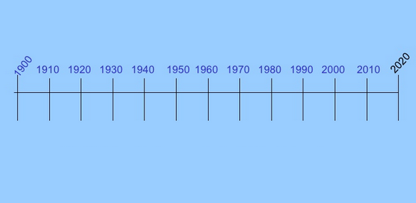
Methods of Calculating Energy Bands
Alt reference: Ashcroft Ch.10-11
Sommerfeld (1927)
Tight Binding (1954)
GW approx. (1965)
Wannier function (1937)
DFT (1964)
k•p
(1955)
Drude (1900)
LCAO (1928)
Muffin-tin approx. (1947)
Hubbard
(1963): Simplest interacting particles
Recently, more of a focus on computational implementation and accuracy
Schrödinger equation (1925)
Kroniq-Penney
(1931)
Notes:
Timeline is incomplete. This is my attempt to put things in perspective.
Others: Kohn–Sham eqs (1965)
GW uses Green’s function. The GWA with W replaced by the bare Coulomb yields nothing other than the Hartree–Fock exchange potential (self-energy). Therefore, loosely speaking, the GWA represents a type of dynamically screened Hartree–Fock self-energy.
Hubbard: the simplest model of interacting particles in a lattice, with only two terms in the Hamiltonian: a kinetic term allowing for tunneling ('hopping') of particles between sites of the lattice and a potential term consisting of an on-site interaction. The Hubbard model is a good approximation for particles in a periodic potential at sufficiently low temperatures that all the particles are in the lowest Bloch band, as long as any long-range interactions between the particles can be ignored. If interactions between particles on different sites of the lattice are included, the model is often referred to as the 'extended Hubbard model'. The model was originally proposed (in 1963) to describe electrons in solids and has since been the focus of particular interest as a model for high-temperature superconductivity. For electrons in a solid, the Hubbard model can be considered as an improvement on the tight-binding model, which includes only the hopping term.

Slide 23
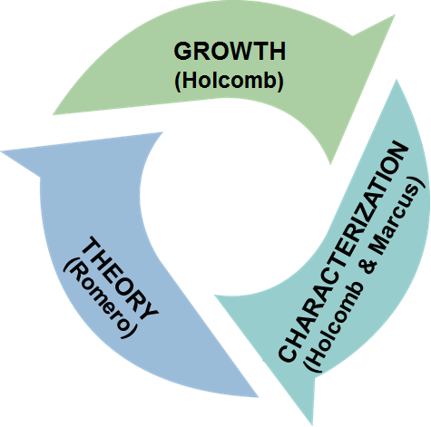
Methods of Calculating Energy Bands
Every single time I don’t get funded from the National Science Foundation, the reviewers note that I haven’t proposed strong enough collaboration with theorists. So… what do you think I do now?
Sommerfeld (1927)
Tight Binding (1954)
GW approx. (1965)
Wannier function (1937)
DFT (1964)
k•p
(1955)
*
Drude (1900)
LCAO (1928)
Muffin-tin approx. (1947)
Hubbard
(1963): Simplest interacting particles
Schrödinger equation (1925)
Kroniq-Penney
(1931)
Notes:
*Disclaimer: I’m not a theorist. However, that fact might be useful when first introducing this topic because I’m almost guaranteed to get too deep into the details. If you want to learn more about these methods, I recommend various solid state books (such as Chapters 10 and 11 in Ashcroft) or the next condensed matter class 772. For any non-condensed matter physicist that maybe doesn’t want to actually take the course, you can always ask to audit it! Better than nothing.

Slide 24
Early Techniques Used The Independent Electron (e⁻) Approx.
An independent SE for each e⁻ is simplification
Notes:
Simply by writing down a separate S.E. for each electron we’ve already made a huge simplification of many interacting electrons. In reality, each electron cannot be described by a wave function determined by a single particle Schrodinger equation, independent of all others.
When you get the same result back, it’s call self consistency
This method is quite sensitive to your original guess. You can get different answers with different guesses. See page 193 for an example.

Slide 25
Early Techniques Used The Independent Electron (e⁻) Approx.
An independent SE for each e⁻ is simplification
The ind. e⁻ approx. however doesn’t ignore all
Notes:
Simply by writing down a separate S.E. for each electron we’ve already made a huge simplification of many interacting electrons. In reality, each electron cannot be described by a wave function determined by a single particle Schrodinger equation, independent of all others.
When you get the same result back, it’s call self consistency
This method is quite sensitive to your original guess. You can get different answers with different guesses. See page 193 in Ashcroft for an example.

Slide 26
Early Techniques Used The Independent Electron (e⁻) Approx.
An independent SE for each e⁻ is simplification
The ind. e⁻ approx. however doesn’t ignore all
U(r)=periodic potential + periodic interactions
Notes:
Simply by writing down a separate S.E. for each electron we’ve already made a huge simplification of many interacting electrons. In reality, each electron cannot be described by a wave function determined by a single particle Schrodinger equation, independent of all others.
When you get the same result back, it’s call self consistency
This method is quite sensitive to your original guess. You can get different answers with different guesses. See page 193 for an example.

Slide 27
Early Techniques Used The Independent Electron (e⁻) Approx.
An independent SE for each e⁻ is simplification
The ind. e⁻ approx. however doesn’t ignore all
U(r)=periodic potential + periodic interactions
To know U(r) with interactions, you need ψ
Notes:
Simply by writing down a separate S.E. for each electron we’ve already made a huge simplification of many interacting electrons. In reality, each electron cannot be described by a wave function determined by a single particle Schrodinger equation, independent of all others.
When you get the same result back, it’s call self consistency
This method is quite sensitive to your original guess. You can get different answers with different guesses. See page 193 for an example.

Slide 28
Early Techniques Used The Independent Electron (e⁻) Approx.
An independent SE for each e⁻ is simplification
The ind. e⁻ approx. however doesn’t ignore all
U(r)=periodic potential + periodic interactions
To know U(r) with interactions, you need ψ
To know ψ, you need U(r) What to do?
Notes:
Simply by writing down a separate S.E. for each electron we’ve already made a huge simplification of many interacting electrons. In reality, each electron cannot be described by a wave function determined by a single particle Schrodinger equation, independent of all others.
When you get the same result back, it’s call self consistency
This method is quite sensitive to your original guess. You can get different answers with different guesses. See page 193 for an example.

Slide 29
Early Techniques Used The Independent Electron (e⁻) Approx.
An independent SE for each e⁻ is simplification
The ind. e⁻ approx. however doesn’t ignore all
U(r)=periodic potential + periodic interactions
To know U(r) with interactions, you need ψ
To know ψ, you need U(r) What to do?
Guess U(r), use to solve ψ Then what?
Notes:
Simply by writing down a separate S.E. for each electron we’ve already made a huge simplification of many interacting electrons. In reality, each electron cannot be described by a wave function determined by a single particle Schrodinger equation, independent of all others.
When you get the same result back, it’s call self consistency
This method is quite sensitive to your original guess. You can get different answers with different guesses. See page 193 for an example.

Slide 30
Early Techniques Used The Independent Electron (e⁻) Approx.
An independent SE for each e⁻ is simplification
The ind. e⁻ approx. however doesn’t ignore all
U(r)=periodic potential + periodic interactions
To know U(r) with interactions, you need ψ
To know ψ, you need U(r) What to do?
Guess U(r), use to solve ψ Then what?
Use to get better guess of U(r), repeat →same
Notes:
Simply by writing down a separate S.E. for each electron we’ve already made a huge simplification of many interacting electrons. In reality, each electron cannot be described by a wave function determined by a single particle Schrodinger equation, independent of all others.
When you get the same result back, it’s call self consistency
This method is quite sensitive to your original guess. You can get different answers with different guesses. See page 193 for an example.

Slide 31

The Independent Electron (e⁻) Approximation & Sch. Equation
An independent SE for each e⁻ is simplification
The ind. e⁻ approx. however doesn’t ignore all
U(r)=periodic potential + periodic interactions
To know U(r) with interactions, you need ψ
To know ψ, you need U(r) What to do?
Guess U(r), use to solve ψ Then what?
Use to get better guess of U(r), repeat →same
Notes:
Simply by writing down a separate S.E. for each electron we’ve already made a huge simplification of many interacting electrons. In reality, each electron cannot be described by a wave function determined by a single particle Schrodinger equation, independent of all others.
When you get the same result back, it’s call self consistency
This method is quite sensitive to your original guess. You can get different answers with different guesses. See page 193 for an example.

Slide 32

Generalizations to all Methods
Except with the simplest 1D examples, the S. E. cannot be solved exactly
All methods require approximations
And high speed computing!

Slide 33
Generalizations to all Methods
Except with the simplest 1D examples, the S. E. cannot be solved exactly
All methods require approximations
And high speed computing!
Thus the type of approximations people have tried has been limited by computing techniques and computing power

Slide 34
Generalizations to all Methods
Except with the simplest 1D examples, the S. E. cannot be solved exactly
All methods require approximations
And high speed computing!
Thus the type of approximations people have tried has been limited by computing techniques and computing power
Focus on higher energy bands as tight binding is pretty good for lower bands

Slide 35
Examples
We’ll cover some examples so that you can see the kind of limitations you can run into and how to get around them.

Slide 36
The Cellular Method (1934)
First iterative approach was the cellular method by Wigner and Seitz (know that name?)
Notes:
Draw coulomb potential on board and discuss how it looks from a top view. Draw lines.
First figure comes in after 2, other figure last
Radial part R as a function of radius r and energy

Slide 37
The Cellular Method (1934)
First iterative approach was the cellular method by Wigner and Seitz (know that name?)
Since we have periodicity, it is enough to solve the S.E. within a single primitive cell C_{o}
Notes:
Draw coulomb potential on board and discuss how it looks from a top view. Draw lines.
First figure comes in after 2, other figure last
Radial part R as a function of radius r and energy

Slide 38
The Cellular Method (1934)
First iterative approach was the cellular method by Wigner and Seitz (know that name?)
Since we have periodicity, it is enough to solve the S.E. within a single primitive cell C_{o}
The wavefunction in other cell is then
Notes:
Draw coulomb potential on board and discuss how it looks from a top view. Draw lines.
First figure comes in after 2, other figure last
Radial part R as a function of radius r and energy

Slide 39
The Cellular Method (1934)
Hexagonal lattice
First iterative approach was the cellular method by Wigner and Seitz (know that name?)
Since we have periodicity, it is enough to solve the S.E. within a single primitive cell C_{o}
The wavefunction in other cell is then
Notes:
Draw coulomb potential on board and discuss how it looks from a top view. Draw lines.
First figure comes in after 2, other figure last
Radial part R as a function of radius r and energy

Slide 40
The Cellular Method (1934)
Hexagonal lattice
First iterative approach was the cellular method by Wigner and Seitz (know that name?)
Since we have periodicity, it is enough to solve the S.E. within a single primitive cell C_{o}
The wavefunction in other cell is then
Notes:
Draw coulomb potential on board and discuss how it looks from a top view. Draw lines.
First figure comes in after 2, other figure last
Radial part R as a function of radius r and energy

Slide 41


The Cellular Method (1934)
Hexagonal lattice
First iterative approach was the cellular method by Wigner and Seitz (know that name?)
Since we have periodicity, it is enough to solve the S.E. within a single primitive cell C_{o}
The wavefunction in other cell is then
ψ is a sum over spherical harmonics, need BCs
Notes:
Draw coulomb potential on board and discuss how it looks from a top view. Draw lines.
First figure comes in after 2, other figure last
Radial part R as a function of radius r and energy

Slide 42
The Cellular Method (1934)
Hexagonal lattice
First iterative approach was the cellular method by Wigner and Seitz (know that name?)
Since we have periodicity, it is enough to solve the S.E. within a single primitive cell C_{o}
The wavefunction in other cell is then
ψ is a sum over spherical harmonics, need BCs
Computationally challenging to solve B.C.s
Notes:
Draw coulomb potential on board and discuss how it looks from a top view. Draw lines.
First figure comes in after 2, other figure last
Radial part R as a function of radius r and energy

Slide 43
The Cellular Method (1934)
Hexagonal lattice
First iterative approach was the cellular method by Wigner and Seitz (know that name?)
Since we have periodicity, it is enough to solve the S.E. within a single primitive cell C_{o}
The wavefunction in other cell is then
ψ is a sum over spherical harmonics, need BCs
Computationally challenging to solve B.C.s
Results in potential with discontinuous derivative at cell boundary
Notes:
Draw coulomb potential on board and discuss how it looks from a top view. Draw lines.
First figure comes in after 2, other figure last
Radial part R as a function of radius r and energy

Slide 44
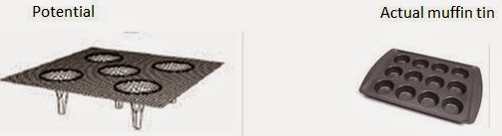
Muffin-tin potential
Solves both complaints of the last method:
One way to make sure continuous at boundary is set to 0 at boundary!
Notes:
Potential derivative still discontinuous but at location that isn’t as problematic

Slide 45
Muffin-tin potential
Solves both complaints of the last method:
One way to make sure continuous is set to 0!
U(r)=V(|r-R|), when |r-R| < r_{o} (the core region)
=V(r_{o})=0, when |r-R| > r_{o} (interstitial region)
r_{o} is less than half of the nearest neighbor distance
Notes:
Potential derivative still discontinuous but at location that isn’t as problematic

Slide 46
Muffin-tin potential
Solves both complaints of the last method:
One way to make sure continuous is set to 0!
U(r)=V(|r-R|), when |r-R| < r_{o} (the core region)
=V(r_{o})=0, when |r-R| > r_{o} (interstitial region)
r_{o} is less than half of the nearest neighbor distance
Of course you are just moving your discontinuous derivative problem, but maybe to better spot?
Notes:
Potential derivative still discontinuous but at location that isn’t as problematic

Slide 47
A discontinuous derivative
(but continuous ψ)
∇²ψ is obviously going to be an issue with a discontinuous derivative, which is why this is always a boundary condition we use in simple Schrodinger equation examples
So, how do we deal with this?
Notes:
figure: By taking different starting potentials, you can get different results

Slide 48
How to deal with a discontinuous derivative (but continuous ψ)
Best to use variational principle rather than S.E.
E[ψ_{k}] is the energy of ε(k) of the level ψ_{k}
Notes:
figure: By taking different starting potentials, you can get different results

Slide 49
How to deal with a discontinuous derivative (but continuous ψ)
Best to use variational principle rather than S.E.
E[ψ_{k}] is the energy of ε(k) of the level ψ_{k}
Drawback:
Different starting potentials can give different results.
Need a good guess.
Notes:
figure: By taking different starting potentials, you can get different results

Slide 50
Two methods use the muffin tin potential
Augmented Plane-Wave method (APW)
Notes:
Due to Slater

Slide 51
Two methods use the muffin tin potential
Augmented Plane-Wave method (APW)
In the interstitial region φ_{k,ε}=e^{ik•r}
Notes:
Due to Slater

Slide 52
Two methods use the muffin tin potential
Augmented Plane-Wave method (APW)
In the interstitial region φ_{k,ε}=e^{ik•r}
In the atomic region, φ_{k,ε} satisfies S.E.
Notes:
Due to Slater

Slide 53
Two methods use the muffin tin potential
Augmented Plane-Wave method (APW)
In the interstitial region φ_{k,ε}=e^{ik•r}
In the atomic region, φ_{k,ε} satisfies S.E.
Only k dependence is in the interstitial region
Notes:
Due to Slater

Slide 54
Two methods use the muffin tin potential
Augmented Plane-Wave method (APW)
In the interstitial region φ_{k,ε}=e^{ik•r}
In the atomic region, φ_{k,ε} satisfies S.E.
Only k dependence is in the interstitial region
In interstitial region:
Notes:
Due to Slater

Slide 55
Two methods use the muffin tin potential
Augmented Plane-Wave method (APW)
In the interstitial region φ_{k,ε}=e^{ik•r}
In the atomic region, φ_{k,ε} satisfies S.E.
Only k dependence is in the interstitial region
In interstitial region:
Thousands of APWs can be used
Notes:
Due to Slater

Slide 56
Another approach using Muffin tin
The other method is called the Green’s function approach or the Korringa, Kohn, and Rostoker (KKR) method

Slide 57
Another approach using Muffin tin
The other method is called the Green’s function approach or the Korringa, Kohn, and Rostoker (KKR) method
Formulation seems very different, but it has been established that the methods yield the same results using the same potential
So I won’t talk as much about it

Slide 58
Another approach using Muffin tin
The other method is called the Green’s function approach or the Korringa, Kohn, and Rostoker (KKR) method
Formulation seems very different, but it has been established that the methods yield the same results using the same potential

Slide 59
Orthogonalized plane wave method (OPW)
Good if don’t want a doctored potential
Notes:
Since core wave functions and plane wave e^ikr satisfy Bloch condition, so will OPW wavefunction

Slide 60
Orthogonalized plane wave method (OPW)
Good if don’t want a doctored potential
Orthogonalized plane waves defined as:
Notes:
Since core wave functions and plane wave e^ikr satisfy Bloch condition, so will OPW wavefunction

Slide 61
Orthogonalized plane wave method (OPW)
Good if don’t want a doctored potential
Orthogonalized plane waves defined as:
Core levels needed (generally tight binding)
Notes:
Since core wave functions and plane wave e^ikr satisfy Bloch condition, so will OPW wavefunction

Slide 62
Orthogonalized plane wave method (OPW)
Good if don’t want a doctored potential
Orthogonalized plane waves defined as:
Core levels needed (generally tight binding)
Constants b_{c} determined by orthogonality
Notes:
Since core wave functions and plane wave e^ikr satisfy Bloch condition, so will OPW wavefunction

Slide 63
Orthogonalized plane wave method (OPW)
Good if don’t want a doctored potential
Orthogonalized plane waves defined as:
Core levels needed (generally tight binding)
Constants b_{c} determined by orthogonality
This implies
Notes:
Since core wave functions and plane wave e^ikr satisfy Bloch condition, so will OPW wavefunction

Slide 64
Orthogonalized plane wave method (OPW)
Good if don’t want a doctored potential
Orthogonalized plane waves defined as:
Core levels needed (generally tight binding)
Constants b_{c} determined by orthogonality
This implies
Second term small in interstitial region
Notes:
Since core wave functions and plane wave e^ikr satisfy Bloch condition, so will OPW wavefunction

Slide 65
Orthogonalized plane wave method (OPW)
Good if don’t want a doctored potential
Orthogonalized plane waves defined as:
Core levels needed (generally tight binding)
Constants b_{c} determined by orthogonality
This implies
Second term small in interstitial region
So close to a plane wave in interstitial region
Notes:
Since core wave functions and plane wave e^ikr satisfy Bloch condition, so will OPW wavefunction

Slide 66
Pseudopotential Method
Began as an extension of OPW

Slide 67
Pseudopotential Method
Began as an extension of OPW
If we act H on

Slide 68
Pseudopotential Method
Began as an extension of OPW
If we act H on
In the outer region, this gives ~ free energy

Slide 69
Pseudopotential Method
Began as an extension of OPW
If we act H on
In the outer region, this gives ~ free energy
What goes on in core is largely irrelevant to the energy, so let’s just ignore it

Slide 70
Pseudopotential Method
Began as an extension of OPW
If we act H on
In the outer region, this gives ~ free energy
What goes on in core is largely irrelevant to the energy, so let’s just ignore it
U(r)=0 , when r < R_{e} (the core region)
=-e²/r, when r > R_{e} (interstitial region)

Slide 71
Pseudopotential Method
Calculation of band structure depends only on the Fourier components of the pseudopotential at the reciprocal lattice vectors (edges of the BZ).
Notes:
Not sure there is time for this, so pushing it behind the summary

Slide 72
Pseudopotential Method
Calculation of band structure depends only on the Fourier components of the pseudopotential at the reciprocal lattice vectors (edges of the BZ).
Usually, only a few values of U are needed
Notes:
Not sure there is time for this, so pushing it behind the summary

Slide 73
Pseudopotential Method
Calculation of band structure depends only on the Fourier components of the pseudopotential at the reciprocal lattice vectors (edges of the BZ).
Usually, only a few values of U are needed
Constants from models or fits to optical measurements of reflectance and absorption
Notes:
Not sure there is time for this, so pushing it behind the summary

Slide 74
Pseudopotential Method
Calculation of band structure depends only on the Fourier components of the pseudopotential at the reciprocal lattice vectors (edges of the BZ).
Usually, only a few values of U are needed
Constants from models or fits to optical measurements of reflectance and absorption
Great predictive value for new compounds
Notes:
Not sure there is time for this, so pushing it behind the summary

Slide 75
Pseudopotential Method
Calculation of band structure depends only on the Fourier components of the pseudopotential at the reciprocal lattice vectors (edges of the BZ).
Usually, only a few values of U are needed
Constants from models or fits to optical measurements of reflectance and absorption
Great predictive value for new compounds
Often possible to calculate band structures, cohesive energy, lattice constants and bulk moduli from first principles
Notes:
Not sure there is time for this, so pushing it behind the summary

Slide 76
Nearly free e⁻’s
Large overlap
Wave functions ~ plane waves
Assume energy is unchanged and solve for 1st order correction
Tight-binding/LCMO
Assume some electrons indep. of each other
Linear combination of
Wannier functions = unperturbed atomic orbital
Notes:
Electron correlation=electron-electron interactions

Slide 77
Nearly free e⁻’s
Large overlap
Wave functions ~ plane waves
Assume energy is unchanged and solve for 1st order correction
Tight-binding/LCMO
Assume some electrons indep. of each other
Linear combination of
Wannier functions = unperturbed atomic orbital
Pseudopotential Method includes Coulomb repulsion & Pauli exclusion. No exact way to calculate V(r), guess and iterate. Valence bands->charge density=ѱ*ѱ->V’
Notes:
Electron correlation=electron-electron interactions

Slide 78
Nearly free e⁻’s
Large overlap
Wave functions ~ plane waves
Assume energy is unchanged and solve for 1st order correction
Tight-binding/LCMO
Assume some electrons indep. of each other
Linear combination of
Wannier functions = unperturbed atomic orbital
Pseudopotential Method includes Coulomb repulsion & Pauli exclusion. No exact way to calculate V(r), guess and iterate. Valence bands->charge density=ѱ*ѱ->V’
Density functional theory (DFT) takes into account Coulomb, exchange and correlation energies of electrons. Guess and iterate. Gives good bandstructure.
Notes:
Electron correlation=electron-electron interactions

Slide 79
Basics of DFT-LDA (+U)
DFT’s failures: Materials containing localized d and f electrons whose contributions to exchange and correlation are not accurately computed in the commonly used local density approximation.
Notes:
Local-density approximations (LDA) are a class of approximations to the exchange–correlation energy functional in density functional theory (DFT) that depend solely upon the value of the electronic density at each point in space.
Technically, not a good Mott insulator, but haven’t discussed that yet (hope to get to it in rest of semiconductor stuff)

Slide 80
Basics of DFT-LDA (+U)
DFT’s failures: Materials containing localized d and f electrons whose contributions to exchange and correlation are not accurately computed in the commonly used local density approximation.
Most basic fix is LDA+U, where to the DFT functional is added an orbital-dependent interaction term characterized by an energy scale U, the screened Coulomb interaction between the correlated orbitals. Success = the high temperature superconducting cuprates.
Notes:
Local-density approximations (LDA) are a class of approximations to the exchange–correlation energy functional in density functional theory (DFT) that depend solely upon the value of the electronic density at each point in space.
Technically, not a good Mott insulator, but haven’t discussed that yet (hope to get to it in rest of semiconductor stuff)

Slide 81
Basics of DFT-LDA (+U)
DFT’s failures: Materials containing localized d and f electrons whose contributions to exchange and correlation are not accurately computed in the commonly used local density approximation.
Most basic fix is LDA+U, where to the DFT functional is added an orbital-dependent interaction term characterized by an energy scale U, the screened Coulomb interaction between the correlated orbitals. Success = the high temperature superconducting cuprates.
LDA+U’s notable failures. While there are exceptions, it is not expected to adequately describe a system which is not a good insulator.
Notes:
Local-density approximations (LDA) are a class of approximations to the exchange–correlation energy functional in density functional theory (DFT) that depend solely upon the value of the electronic density at each point in space.
Technically, not a good Mott insulator, but haven’t discussed that yet (hope to get to it in rest of semiconductor stuff)

Slide 82
Dynamical Mean Field Theory (Tudor)
DMFT (or LDA+DMFT) goes beyond LDA+U by allowing the interaction potential of the correlated orbitals to be energy (frequency) dependent.
Notes:
Could make analogy with Einstein vs Debye models in phonon calculations.

Slide 83
Dynamical Mean Field Theory (Tudor)
DMFT (or LDA+DMFT) goes beyond LDA+U by allowing the interaction potential of the correlated orbitals to be energy (frequency) dependent.
This frequency dependent potential, or self-energy, is computed for the correlated orbitals only using many-body techniques within an accurate impurity solver.
Notes:
Could make analogy with Einstein vs Debye models in phonon calculations.

Slide 84
Dynamical Mean Field Theory (Tudor)
DMFT (or LDA+DMFT) goes beyond LDA+U by allowing the interaction potential of the correlated orbitals to be energy (frequency) dependent.
This frequency dependent potential, or self-energy, is computed for the correlated orbitals only using many-body techniques within an accurate impurity solver.
This calculation can be done as accurately as one desires, and it is significantly cheaper in CPU time than solving a full many-body problem
Notes:
Could make analogy with Einstein vs Debye models in phonon calculations.

Slide 85
Nearly free e⁻’s
Large overlap
Wave functions ~ plane waves
Assume energy is unchanged and solve for 1st order correction
Tight-binding/LCMO
Assume some electrons indep. of each other
Linear combination of
Wannier functions = unperturbed atomic orbital
k·p Theory
Useful for understanding interactions between bands
Pseudopotential Method includes Coulomb repulsion & Pauli exclusion. No exact way to calculate V(r), guess and iterate. Valence bands->charge density=ѱ*ѱ->V’
Density functional theory (DFT) takes into account Coulomb, exchange and correlation energies of electrons. Guess and iterate. Gives good bandstructure.
Notes:
Electron correlation=electron-electron interactions

Slide 86
Nearly free e⁻’s
Large overlap
Wave functions ~ plane waves
Assume energy is unchanged and solve for 1st order correction
Tight-binding/LCMO
Assume some electrons indep. of each other
Linear combination of
Wannier functions = unperturbed atomic orbital
k·p Theory
Useful for understanding interactions between bands
Critical points of BZ have specific properties.
Pseudopotential Method includes Coulomb repulsion & Pauli exclusion. No exact way to calculate V(r), guess and iterate. Valence bands->charge density=ѱ*ѱ->V’
Density functional theory (DFT) takes into account Coulomb, exchange and correlation energies of electrons. Guess and iterate. Gives good bandstructure.
Notes:
Electron correlation=electron-electron interactions

Slide 87
Nearly free e⁻’s
Large overlap
Wave functions ~ plane waves
Assume energy is unchanged and solve for 1st order correction
Tight-binding/LCMO
Assume some electrons indep. of each other
Linear combination of
Wannier functions = unperturbed atomic orbital
k·p Theory
Useful for understanding interactions between bands
Critical points of BZ have specific properties.
If critical point energies are known, treat nearby points as critical energy plus perturbation
Notes:
Electron correlation=electron-electron interactions

Slide 88
k○p Theory
Most holes (electrons) spend most of their time near the top (bottom) of the valence (conduction) band so properties nearby these points important

Slide 89

k○p Theory
Most holes (electrons) spend most of their time near the top (bottom) of the valence (conduction) band so properties nearby these points important
Based on perturbation theory
V~ is the periodic potential (of the lattice), and V_{U} is the confinement potential

Slide 90

k○p Theory
Most holes (electrons) spend most of their time near the top (bottom) of the valence (conduction) band so properties nearby these points important
Based on perturbation theory
V~ is the periodic potential (of the lattice), and V_{U} is the confinement potential
V₀ and x₀ are some arbitrary positive constants. If V_{U} is small, then the solutions to the S.E. are of the Bloch form:

Slide 91
Essense of k○p Theory
Reference in notes
Plug Bloch into S.E.
Notes:
In some past classes, I’ve done the math on the board to show the kdotp term but I don’t really think it helped, so I’m just giving it here.
When we plug in the Bloch wavefunction, we can write the Schrodinger equation in this form.
Honestly, kind of a pain to show, see original paper: http://journals.aps.org/pr/pdf/10.1103/PhysRev.97.869

Slide 92

Essense of k○p Theory
Reference in notes
Plug Bloch into S.E.
After lots of manipulation:
When we plug in the Bloch wavefunction, we can write the Schrodinger equation in this form.
E’_{k}
Notes:
In some past classes, I’ve done the math on the board to show the kdotp term but I don’t really think it helped, so I’m just giving it here.
When we plug in the Bloch wavefunction, we can write the Schrodinger equation in this form.
Honestly, kind of a pain to show, see original paper: http://journals.aps.org/pr/pdf/10.1103/PhysRev.97.869

Slide 93
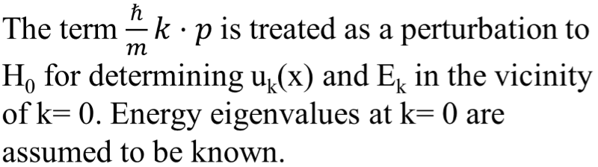
Essense of k○p Theory
Reference in notes
Plug Bloch into S.E.
After lots of manipulation:
When we plug in the Bloch wavefunction, we can write the Schrodinger equation in this form.
E’_{k}
Notes:
In some past classes, I’ve done the math on the board to show the kdotp term but I don’t really think it helped, so I’m just giving it here.
When we plug in the Bloch wavefunction, we can write the Schrodinger equation in this form.
Honestly, kind of a pain to show, see original paper: http://journals.aps.org/pr/pdf/10.1103/PhysRev.97.869

